Slide 1
Employee Data Analysis using Excel
STUDENT NAME: SAMUEL.J
REGISTER NO:312211809 /22BCOMCA05
DEPARTMENT:B.COM(COMPUTER APPLICATION)
COLLEGE: THIRUTHANGAL NADAR COLLEGE

Slide 2
PROJECT TITLE
Employee Performance Analysis using Excel

Slide 3


AGENDA
Problem Statement
Project Overview
End Users
Our Solution and Proposition
Dataset Description
Modelling Approach
Results and Discussion
Conclusion
3/21/2024 Annual Review

Slide 4

PROBLEM STATEMENT
1: Employee Turnover Prediction"A large retail company is experiencing high employee turnover rates, resulting in significant recruitment and training costs. Analyze employee data to identify key factors contributing to turnover and develop a predictive model to identify at-risk employees.“
2: Diversity and Inclusion"A tech firm wants to improve diversity and inclusion in its workforce. Analyze employee demographic data to identify areas for improvement and recommend strategies to enhance diversity and inclusion metrics."
Data Requirements:- Employee demographics (age, gender, department, job role)- Performance metrics (evaluations, promotions)- Attendance and leave records- Training and development data- Survey responses (engagement, satisfaction)- Turnover and churn data

Slide 5

PROJECT OVERVIEW
Analyze employee data to gain insights into employee behavior, performance, and sentiment, informing HR strategies and decisions to enhance employee engagement, retention, and productivity.
Project Scope:
1. Data Collection: Gather employee data from various sources (HR systems, surveys, performance metrics).
2. Data Cleaning and Preparation: Ensure data quality, handle missing values, and transform data for analysis.

Slide 6

WHO ARE THE END USERS?
HR Managers: Utilize insights for talent management, recruitment, and employee development.
2. Business Leaders: Inform strategic decisions on workforce planning, productivity, and performance.
3. Talent Acquisition Teams: Leverage data for recruitment marketing, candidate sourcing, and hiring.
4. Learning and Development Teams: Analyze training effectiveness and identify skill gaps.
5. Compensation and Benefits Teams: Determine fair compensation and benefits packages.
1. Recruitment Analysts2. HR Business Partners3. Talent Management Specialists4. Workforce Planning Analysts5. Compensation Analysts

Slide 7

OUR SOLUTION AND ITS VALUE PROPOSITION
EIP is a cutting-edge employee data analysis platform that provides actionable insights to enhance employee engagement, retention, and productivity. By leveraging machine learning, natural language processing, and data visualization, EIP helps
organizations:
Predict employee turnover and identify at-risk employees
Analyze diversity, equity, and inclusion metrics
Optimize talent development and succession planning
Improve employee engagement and well-being
Inform data-driven HR decision-making

Slide 8
Dataset Description
EMPLOYEE=KAGGLE.COM
26-FEATURES
9-FEATURE
EMP ID –NUM
NAME-TEXT
EMP TYPE
PERFORMANCE LEVEL
GENDER-MALE FEMALE
EMPLOYEE RATING

Slide 9

THE "WOW" IN OUR SOLUTION
PERFORMANCE LEVEL = IFS(Z8>=5,”VERY HIGH”,Z8>=4”HIGH”.Z8>=3,”MED”,TURE,”LOW”)
3/21/2024 Annual Review
9

Slide 10
MODELLING
Employee Data Analysis Metrics
Employee Turnover Rate
Employee Engagement Score
Performance Metrics (Productivity, Quality) .
Diversity and Inclusion Metrics
Training Effectiveness Metrics
Compensation Metrics (Cost, ROI)
his modeling framework provides a comprehensive structure for employee data analysis, covering data modeling, predictive modeling, statistical modeling, machine learning algorithms, data visualization, and model evaluation metrics.
10

Slide 11
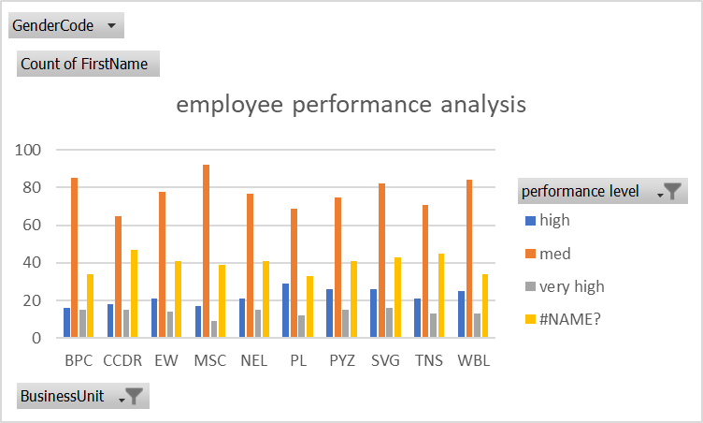
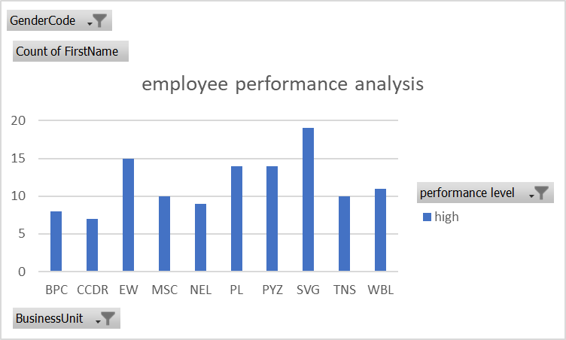
RESULTS
11

Slide 12
conclusion
Employee data analysis is a powerful tool for organizations to gain insights into their workforce, drive business outcomes, and create a better workplace experience. By leveraging advanced analytics techniques, machine learning algorithms, and data visualization tools
Key Takeaways:
Employee data analysis is critical for strategic HR decision-making.
Advanced analytics techniques can uncover hidden patterns and insights
Data-driven approaches improve employee engagement, retention, and productivity.

